Slide 1
CS 295A/395D: Artificial Intelligence
Probabilistic state over time:
Markov Chains
Prof. Emma Tosch
20 April 2022

Slide 2
Logistics
Reminder: worksheet due in class on Friday
Post questions to Teams
Be sure to get started on your programming assignment
Reminder: you may work in pairs!

Slide 3
Today: Markov Chains (i.e., probabilistic state transitions)

Slide 4

Recall: LTL Example
s4
s3
p, q
p, r
Example:
p = Yar alive
q = Yar on our ship
r = transporter ready
s1
p, q, r
p
s2
r
s6
s5

Slide 5
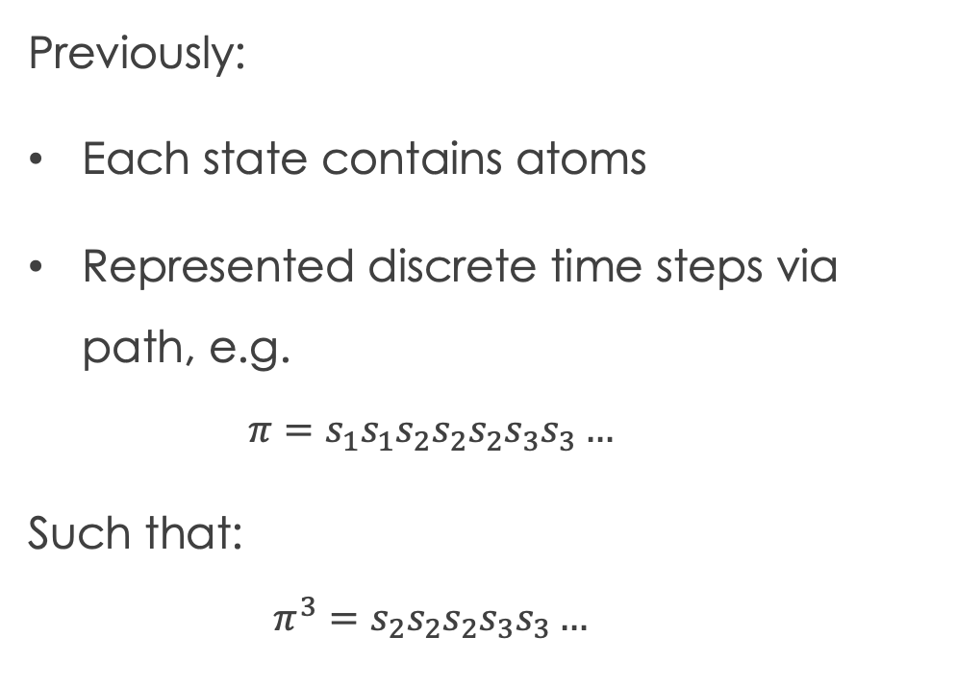
Previously:
Each state contains atoms
Represented discrete time steps via path, e.g.
$$π=s_{1}s_{1}s_{2}s_{2}s_{2}s_{3}s_{3}…$$
Such that:
$$π^{3}=s_{2}s_{2}s_{2}s_{3}s_{3}…$$
s4
s3
p, q
p, r
s1
p, q, r
p
s2
r
s6
s5
What if paths are probabilistic?

Slide 6
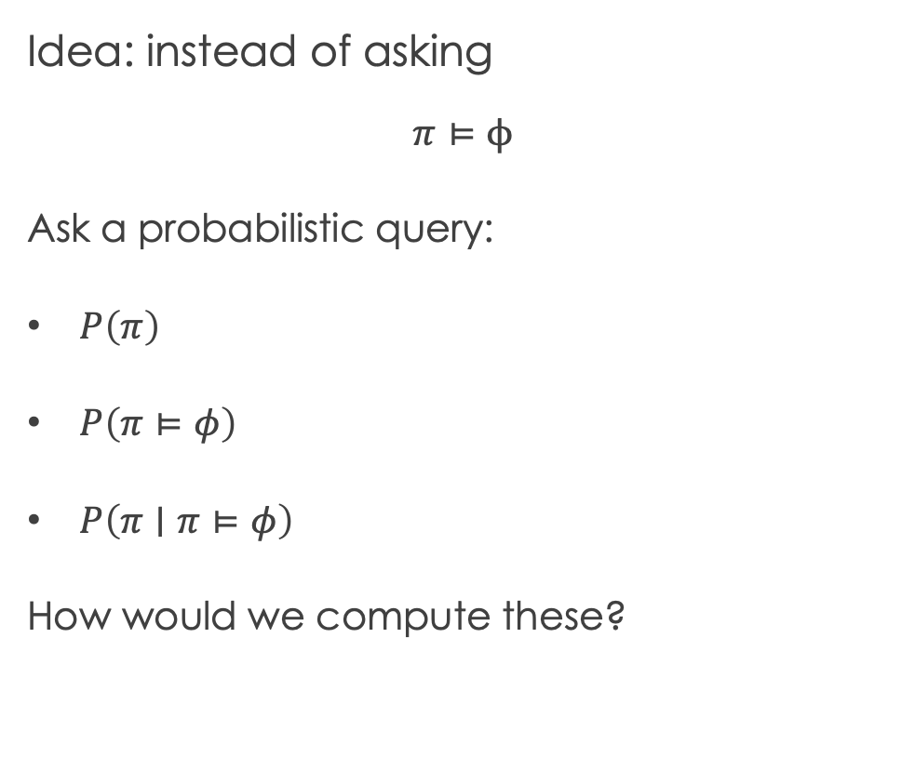
Idea: instead of asking
$$π⊨ϕ$$
Ask a probabilistic query:
$P\left(π\right)$
$P\left(π⊨φ\right)$
$P\left(π∣π⊨φ\right)$
How would we compute these?
s4
s3
p, q
p, r
s1
p, q, r
p
s2
r
s6
s5

Slide 7
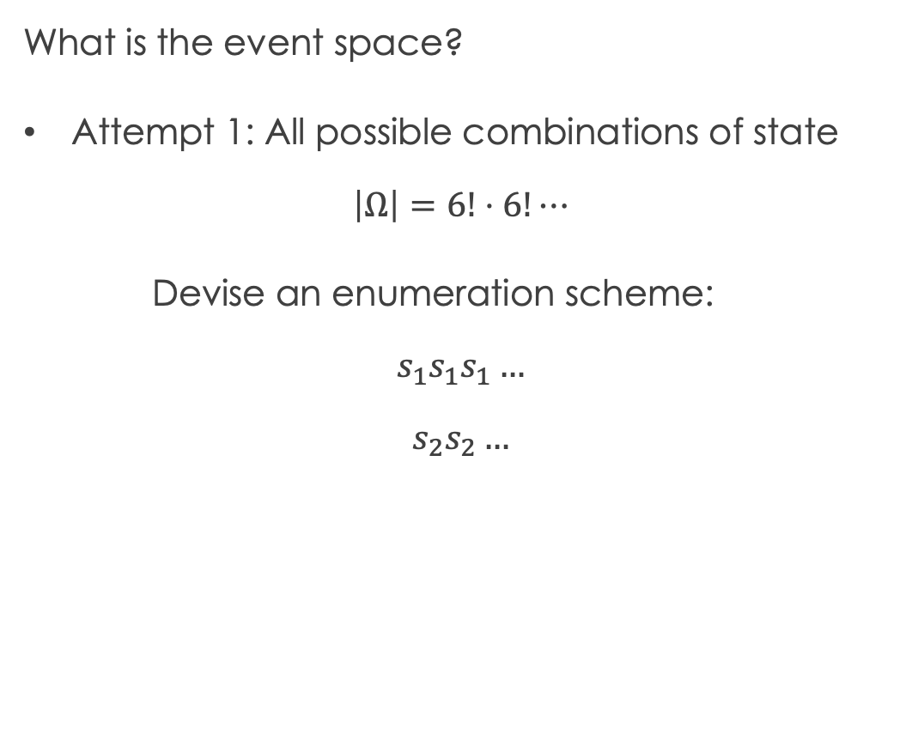
What is the event space?
Attempt 1: All possible combinations of state
$$\left|Ω\right|=6!⋅6!⋯$$
Devise an enumeration scheme:
$$s_{1}s_{1}s_{1}…$$
$$s_{2}s_{2}…$$
s4
s3
p, q
p, r
s1
p, q, r
p
s2
Not a valid path according to our model!
r
s6
s5

Slide 8
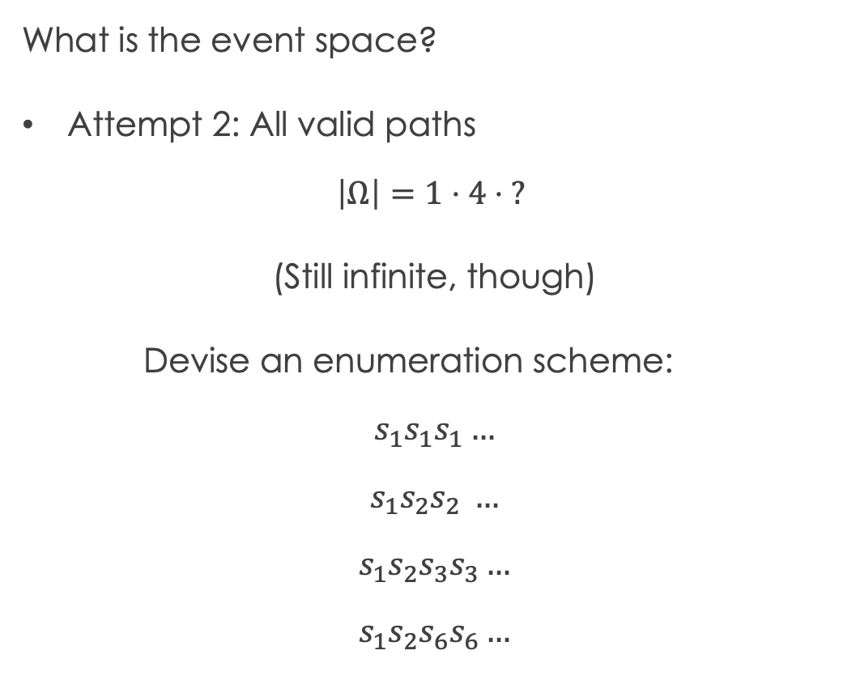
What is the event space?
Attempt 2: All valid paths
$$\left|Ω\right|=1⋅4⋅ ?$$
(Still infinite, though)
Devise an enumeration scheme:
$$s_{1}s_{1}s_{1}…$$
$$s_{1}s_{2}s_{2} …$$
$$s_{1}s_{2}s_{3}s_{3}…$$
$$s_{1}s_{2}s_{6}s_{6}…$$
s4
s3
p, q
p, r
s1
p, q, r
p
s2
Now what?
r
s6
s5

Slide 9
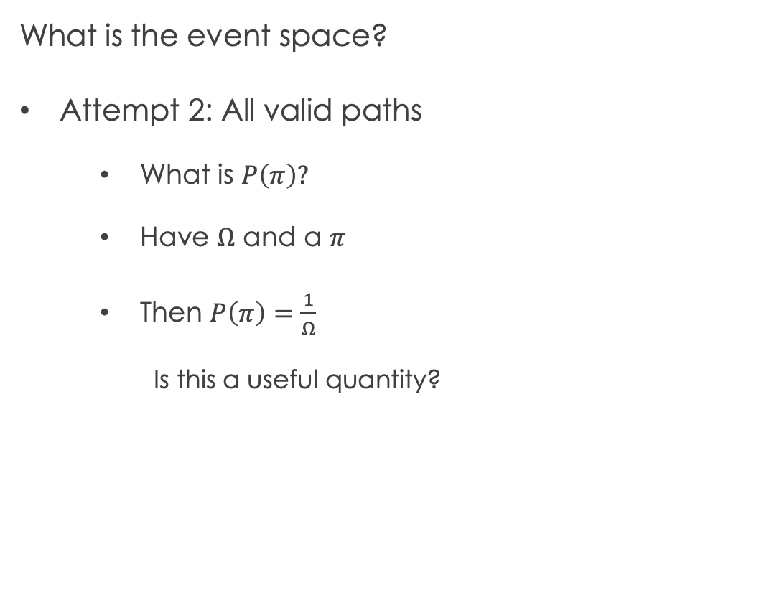
What is the event space?
Attempt 2: All valid paths
What is $P\left(π\right)?$
Have $Ω$ and a $π$
Then $P\left(π\right)=\frac{1}{Ω}$
Is this a useful quantity?
s4
s3
p, q
p, r
s1
p, q, r
p
s2
r
s6
s5

Slide 10
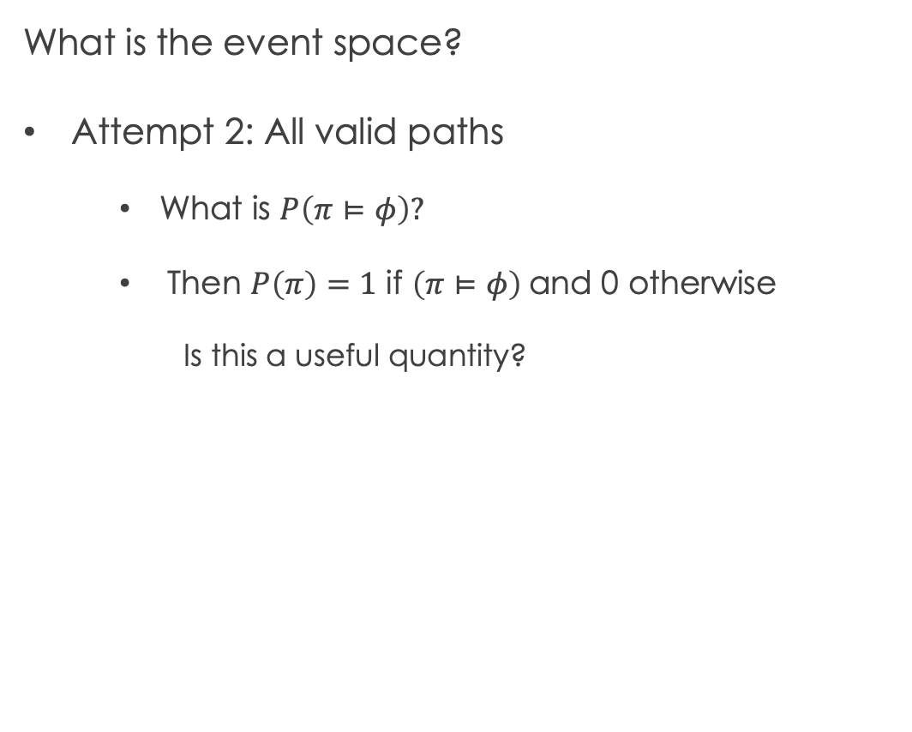
What is the event space?
Attempt 2: All valid paths
What is $P\left(π⊨φ\right)?$
Then $P\left(π\right)=1$ if $\left(π⊨φ\right)$and 0 otherwise
Is this a useful quantity?
s4
s3
p, q
p, r
s1
p, q, r
p
s2
r
s6
s5

Slide 11
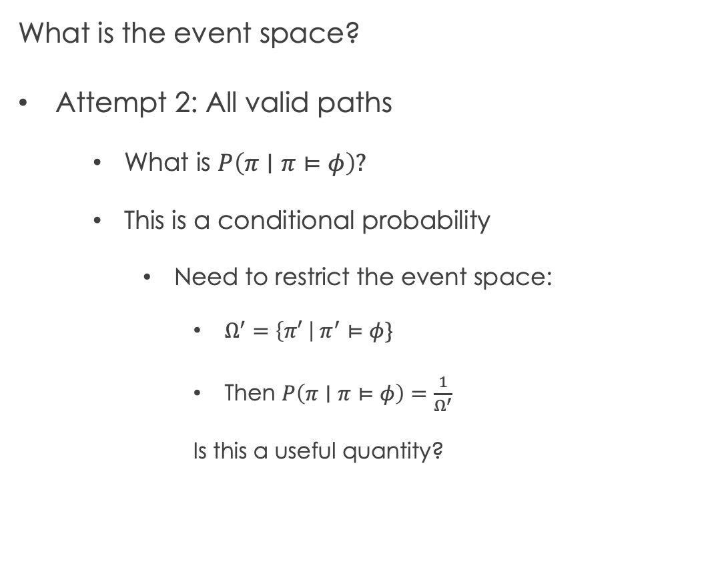
What is the event space?
Attempt 2: All valid paths
What is $P\left(π∣π⊨φ\right)?$
This is a conditional probability
Need to restrict the event space:
$Ω^{′}=\left\{π′ \right| π^{′}⊨φ\}$
Then $P\left(π∣π⊨φ\right)=\frac{1}{Ω^{′}}$
Is this a useful quantity?
s4
s3
p, q
p, r
s1
p, q, r
p
s2
r
s6
s5

Slide 12


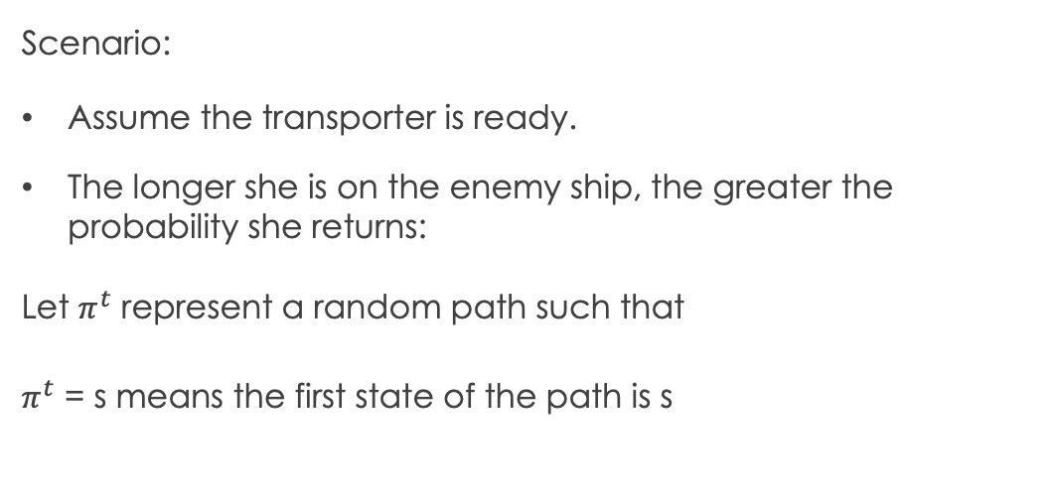
Problem: Assumes all paths equally likely!
${P(s}_{1}s_{1}…)=P(s_{1}s_{2}…)?$
s4
s3
p, q
p, r
Scenario:
Assume the transporter is ready.
The longer she is on the enemy ship, the greater the probability she returns:
Let $π^{t}$ represent a random path such that
$π^{t}$ = s means the first state of the path is s
s1
p, q, r
p
s2
r
s6
$$P\left(π^{t}=s_{4} ∣ π^{t−1}=s_{3},{ π}^{t−2}=s_{3}\right)>$$
$$P\left(π^{t}=s_{4} ∣ π^{t−1}=s_{3},{ π}^{t−2}=s_{2}\right)$$
s5

Slide 13
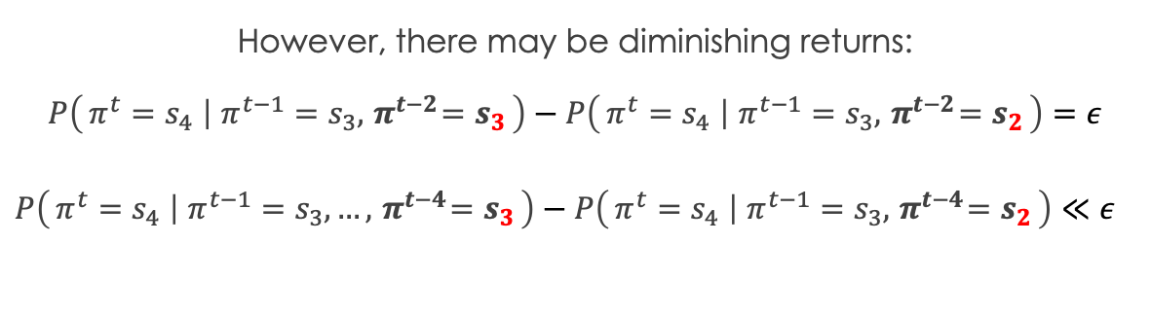

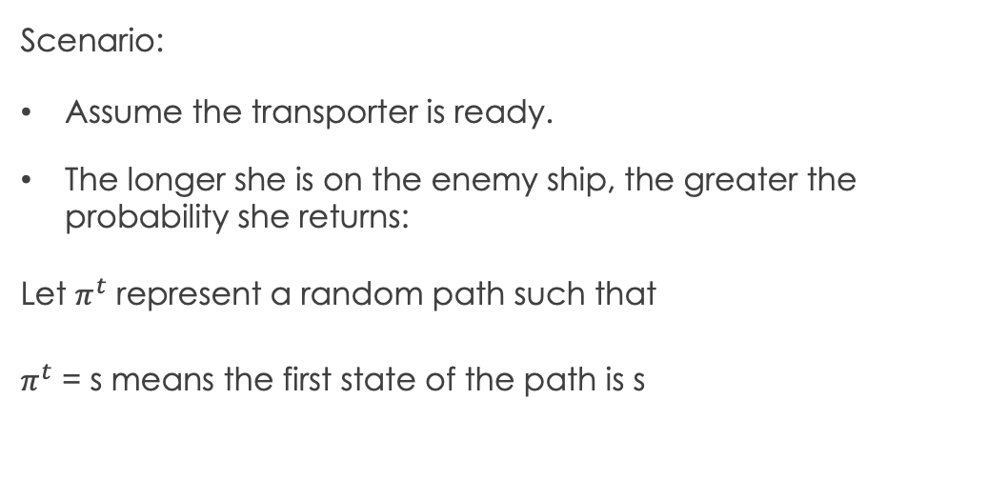
Scenario:
Assume the transporter is ready.
The longer she is on the enemy ship, the greater the probability she returns:
Let $π^{t}$ represent a random path such that
$π^{t}$ = s means the first state of the path is s
s4
s3
p, q
p, r
s1
p, q, r
p
s2
$$P\left(π^{t}=s_{4} ∣ π^{t−1}=s_{3},{ π}^{t−2}=s_{3}\right)>$$
$$P\left(π^{t}=s_{4} ∣ π^{t−1}=s_{3},{ π}^{t−2}=s_{2}\right)$$
However, there may be diminishing returns:
$$P\left(π^{t}=s_{4} ∣ π^{t−1}=s_{3},{ π}^{t−2}=s_{3}\right)−P\left(π^{t}=s_{4} ∣ π^{t−1}=s_{3},{ π}^{t−2}=s_{2}\right)=ε$$
$P\left(π^{t}=s_{4} ∣ π^{t−1}=s_{3},…,{ π}^{t−4}=s_{3}\right)−P\left(π^{t}=s_{4} ∣ π^{t−1}=s_{3},{ π}^{t−4}=s_{2}\right)≪ε$
r
s6
s5

Slide 14
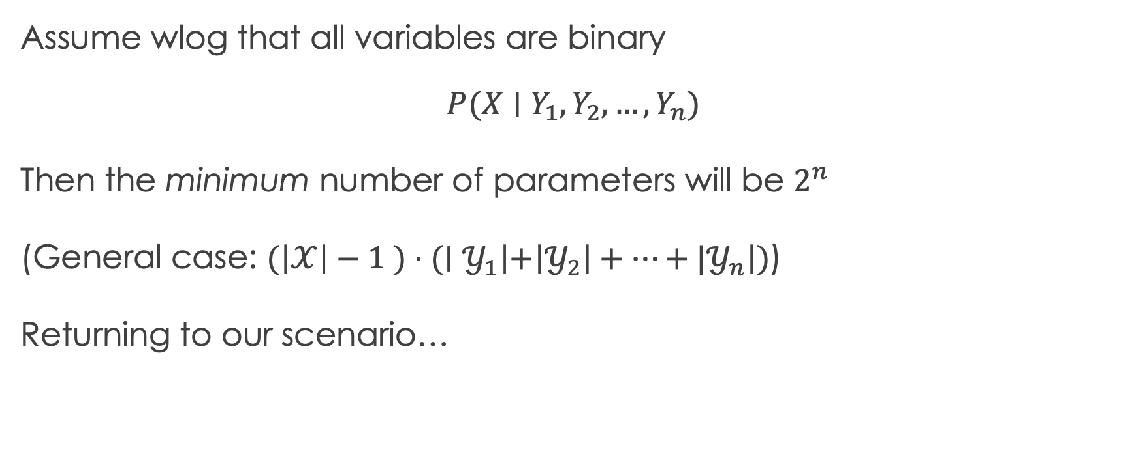
Recall: Conditional probability tables
Assume wlog that all variables are binary
$$P(X∣Y_{1},Y_{2}, …, Y_{n})$$
Then the minimum number of parameters will be $2^{n}$
(General case: $(\left|𝒳\right|−1 )⋅(∣𝒴_{1}\left|+\left|𝒴_{2}\right|+⋯{+ |𝒴}_{n}\right|)$)
Returning to our scenario…

Slide 15

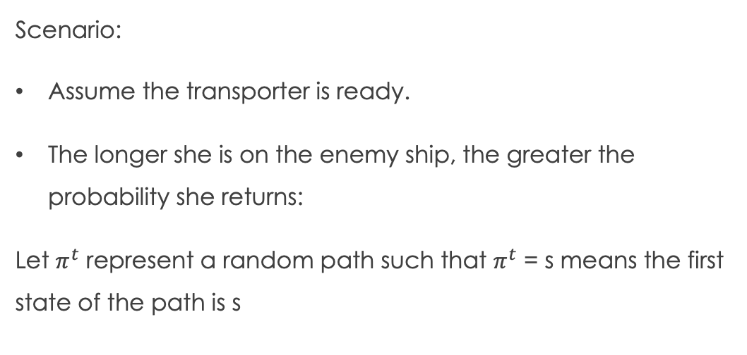
Scenario:
Assume the transporter is ready.
The longer she is on the enemy ship, the greater the probability she returns:
Let $π^{t}$ represent a random path such that $π^{t}$ = s means the first state of the path is s
s4
s3
p, q
p, r
s1
p, q, r
p
s2
$$P\left(π^{t}=s_{4} ∣ π^{t−1}=s_{3},{ π}^{t−2}=s_{3}\right)>$$
$$P\left(π^{t}=s_{4} ∣ π^{t−1}=s_{3},{ π}^{t−2}=s_{2}\right)$$
However, there may be diminishing returns:
$$P\left(π^{t}=s_{4} ∣ π^{t−1}=s_{3},{ π}^{t−2}=s_{3}\right)−P\left(π^{t}=s_{4} ∣ π^{t−1}=s_{3},{ π}^{t−2}=s_{2}\right)=ε$$
$P\left(π^{t}=s_{4} ∣ π^{t−1}=s_{3},…,{ π}^{t−4}=s_{3}\right)−P\left(π^{t}=s_{4} ∣ π^{t−1}=s_{3},{ π}^{t−4}=s_{2}\right)≪ε$
r
s6
s5

Slide 16
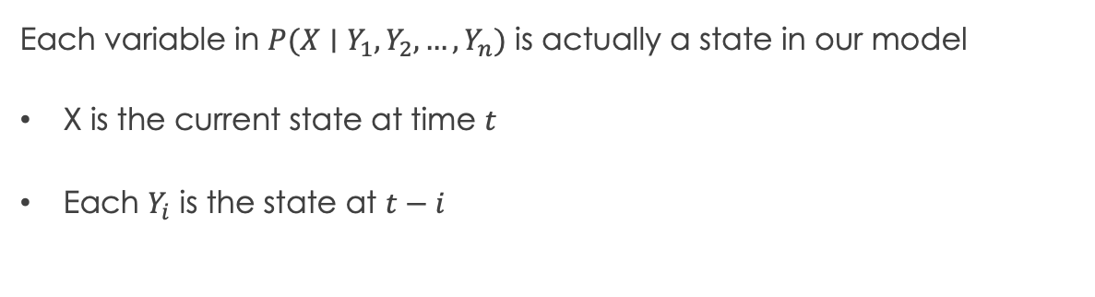
Scenario:
Assume the transporter is ready.
The longer she is on the enemy ship, the greater the probability she returns:
Let $π^{t}$ represent a random path such that $π^{t}$ = s means the first state of the path is s
s4
s3
p, q
p, r
s1
p, q, r
p
s2
$$P\left(π^{t}=s_{4} ∣ π^{t−1}=s_{3},{ π}^{t−2}=s_{3}\right)>$$
$$P\left(π^{t}=s_{4} ∣ π^{t−1}=s_{3},{ π}^{t−2}=s_{2}\right)$$
Each variable in $P(X∣Y_{1},Y_{2}, …, Y_{n})$ is actually a state in our model
X is the current state at time $t_{}$
Each $Y_{i}$ is the state at ${t−i}_{}$
r
s6
s5

Slide 17
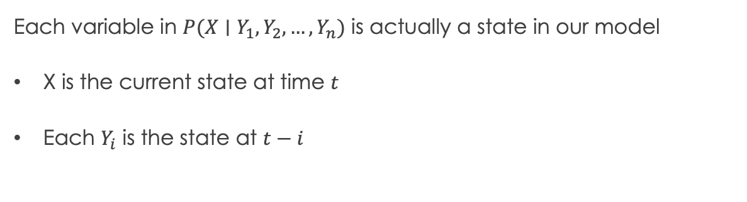
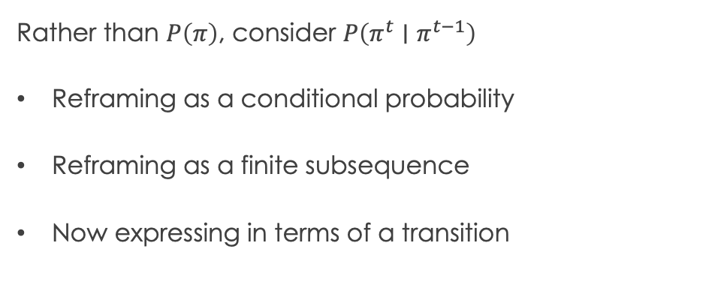
Each variable in $P(X∣Y_{1},Y_{2}, …, Y_{n})$ is actually a state in our model
X is the current state at time $t_{}$
Each $Y_{i}$ is the state at ${t−i}_{}$
s4
s3
p, q
p, r
Rather than $P\left(π\right)$, consider $P\left(π^{t}∣π^{t−1}\right)$
Reframing as a conditional probability
Reframing as a finite subsequence
Now expressing in terms of a transition
s1
p, q, r
p
s2
r
s6
s5

Slide 18

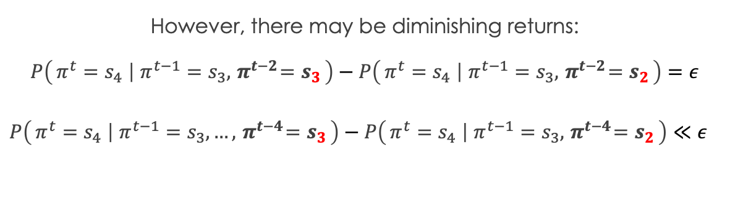
Rather than $P\left(π\right)$, consider $P\left(π^{t}∣π^{t−1}\right)$
Reframing as a conditional probability
Reframing as a finite subsequence
Now expressing in terms of a transition
s4
s3
p, q
p, r
New problem:
number of parameters can grow with the size of the path (i.e., with t)
Recall:
s1
p, q, r
p
s2
r
s6
However, there may be diminishing returns:
$$P\left(π^{t}=s_{4} ∣ π^{t−1}=s_{3},{ π}^{t−2}=s_{3}\right)−P\left(π^{t}=s_{4} ∣ π^{t−1}=s_{3},{ π}^{t−2}=s_{2}\right)=ε$$
$P\left(π^{t}=s_{4} ∣ π^{t−1}=s_{3},…,{ π}^{t−4}=s_{3}\right)−P\left(π^{t}=s_{4} ∣ π^{t−1}=s_{3},{ π}^{t−4}=s_{2}\right)≪ε$
s5

Slide 19
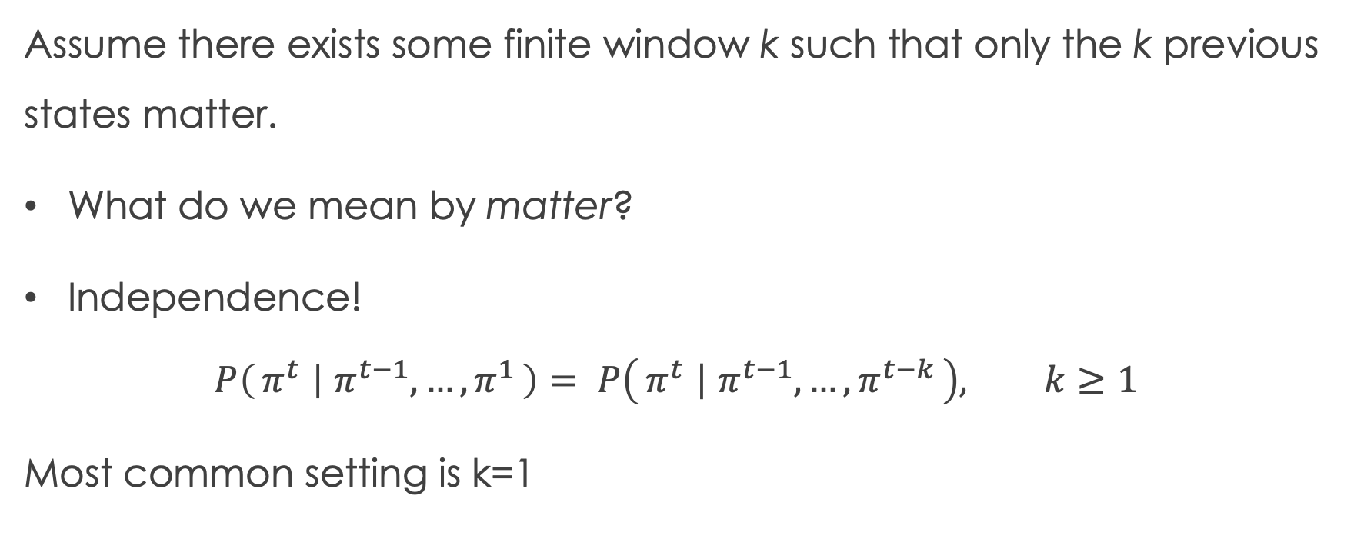
Idea: Simplifying assumption!
Assume there exists some finite window k such that only the k previous states matter.
What do we mean by matter?
Independence!
$$P\left(π^{t} ∣ π^{t−1},…, π^{1}\right)= P\left(π^{t} ∣ π^{t−1},…, π^{t−k}\right), k≥1$$
Most common setting is k=1

Slide 20
Now: can label transitions with probabilities
Why?
This example: assume all transitions are equally likely
Note: previously we assumed all paths equally likely
s4
s3
p, q
p, r
s1
p, q, r
p
s2
r
s6
s5
Example queries on the board

Slide 21
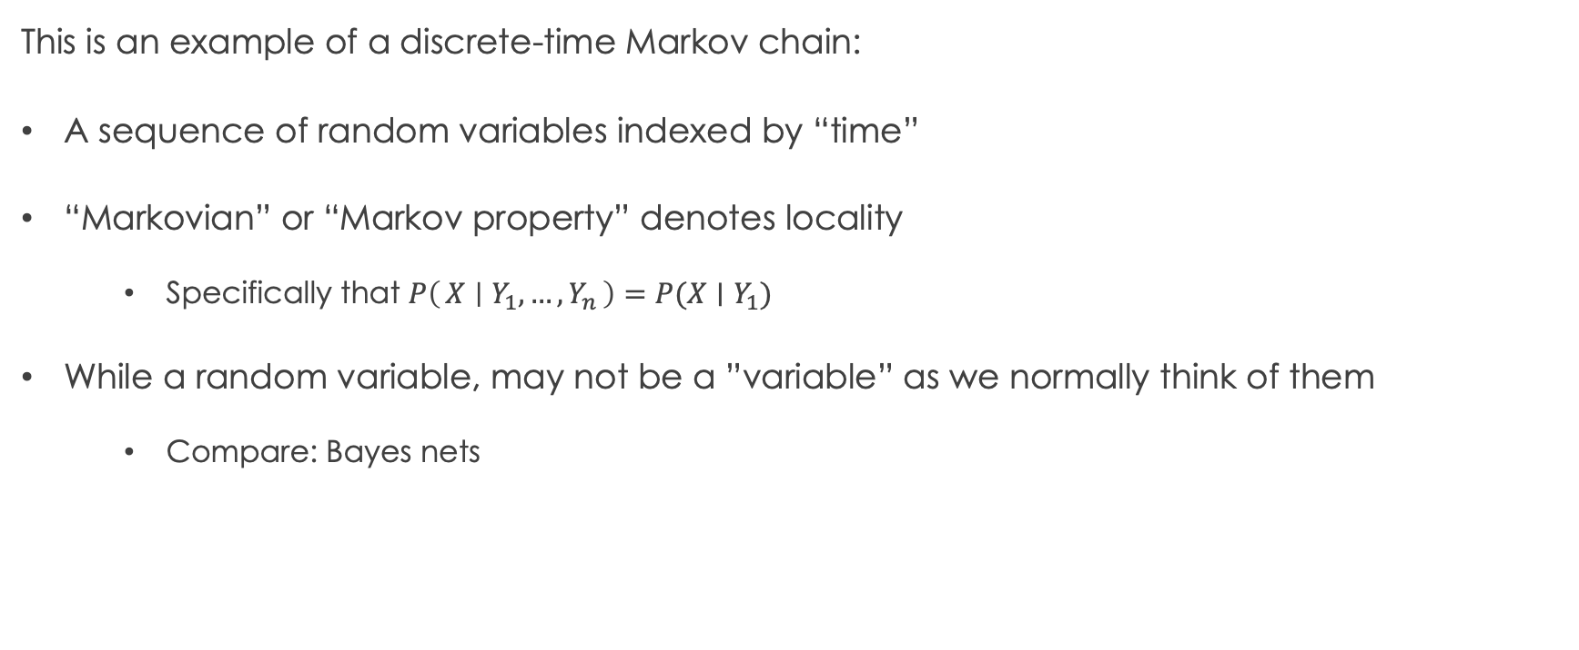
Markov chains
This is an example of a discrete-time Markov chain:
A sequence of random variables indexed by “time”
“Markovian” or “Markov property” denotes locality
Specifically that $P\left(X ∣ Y_{1},…,Y_{n}\right)=P(X∣Y_{1})$
While a random variable, may not be a ”variable” as we normally think of them
Compare: Bayes nets

Slide 22
Markov Chains, formally

Slide 23
Another example
Waiting in line
Every minute, someone joins…
With probability 1 if the line has length 0
With probability 2/3 if the line has length 1
With probability 1/3 if the line has length 2
With probability 0 if the line has length 3
Every minute the server serves someone with probability ½
Suppose one person is in line at noon. How many people do we expect in line at 12:10?

Slide 24
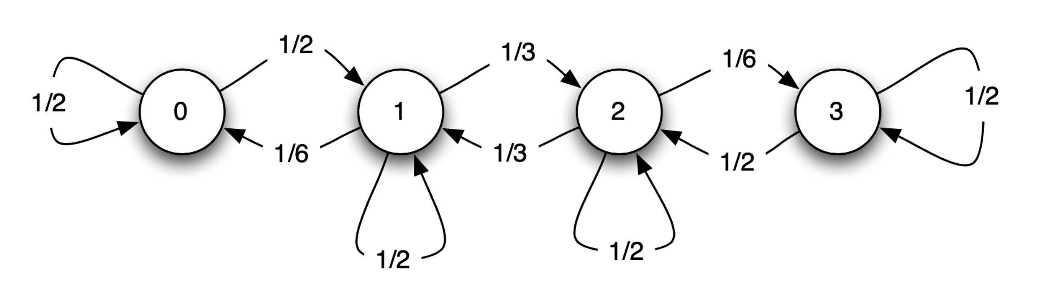
Another example
Waiting in line
Every minute, someone joins…
With probability 1 if the line has length 0
With probability 2/3 if the line has length 1
With probability 1/3 if the line has length 2
With probability 0 if the line has length 3
Every minute the server serves someone with probability ½
Suppose one person is in line at noon. How many people do we expect in line at 12:10?

